Slide 1
JAVA
DEPT OF CSE

Slide 2
MULTITHREADED PROGRAMMING
DEPT OF CSE

Slide 3
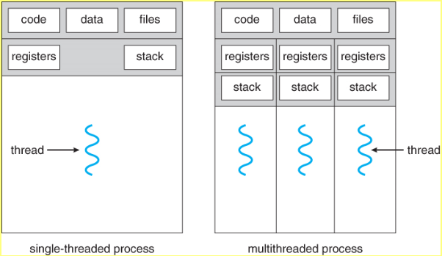

DEPT OF CSE

Slide 4
In a thread-based multitasking environment, the thread is the smallest unit of dispatchable code
Multitasking threads require less overhead than multitasking processes
Processes are heavyweight tasks that require their own separate address spaces
Interprocess communication is expensive and limited
Context switching from one process to another is also costly
DEPT OF CSE

Slide 5
Threads, on the other hand, are lightweight
They share the same address space and cooperatively share the same heavyweight process
Interthread communication is inexpensive, and context switching from one thread to the next is low cost
Multithreading enables you to write very efficient programs that make maximum use of the CPU, because idle time can be kept to a minimum
DEPT OF CSE

Slide 6
The Java Thread Model
DEPT OF CSE

Slide 7
Single-threaded systems use an approach called an event loop with polling
In this model, a single thread of control runs in an infinite loop, polling a single event queue to decide what to do next
Once this polling mechanism returns with, say, a signal that a network file is ready to be read, then the event loop dispatches control to the appropriate event handler
Until this event handler returns, nothing else can happen in the system
DEPT OF CSE

Slide 8
This wastes CPU time
In general, in a singled-threaded environment, when a thread blocks (that is, suspends execution) because it is waiting for some resource, the entire program stops running
When a thread blocks in a Java program, only the single thread that is blocked pauses; All other threads continue to run.
DEPT OF CSE

Slide 9
Threads exist in several states
A thread can be running
It can be ready to run as soon as it gets CPU time
A running thread can be suspended, which temporarily suspends its activity
A suspended thread can then be resumed, allowing it to pick up where it left off
A thread can be blocked when waiting for a resource
At any time, a thread can be terminated, which halts its execution immediately. Once terminated, a thread cannot be resumed
DEPT OF CSE

Slide 10
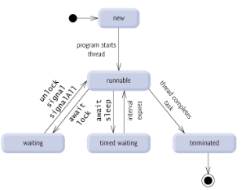
DEPT OF CSE

Slide 11
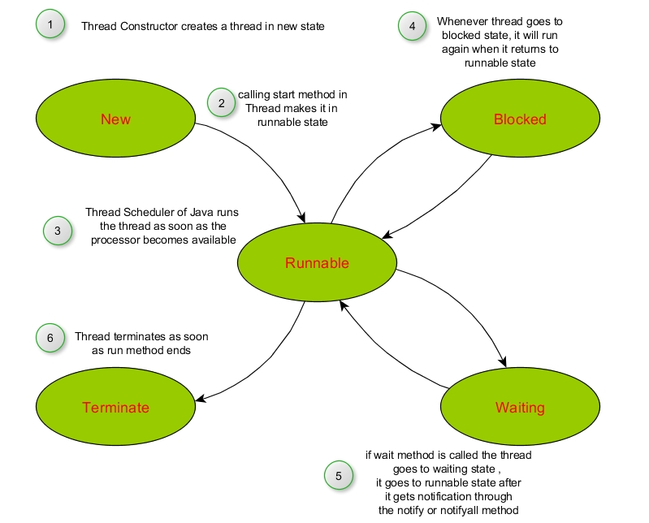
DEPT OF CSE

Slide 12
Thread Priorities
Java assigns to each thread a priority that determines how that thread should be treated with respect to the others
Thread priorities are integers that specify the relative priority of one thread to another
A thread’s priority is used to decide when to switch from one running thread to the next
This is called a context switch
DEPT OF CSE

Slide 13
The rules that determine when a context switch takes place are:
A thread can voluntarily relinquish control
A thread can be preempted by a higher-priority thread
DEPT OF CSE

Slide 14
Synchronization
Java implements synchronization using monitor
Once a thread enters a monitor, all other threads must wait until that thread exits the monitor
Once a thread is inside a synchronized method, no other thread can call any other synchronized method on the same object
DEPT OF CSE

Slide 15
Messaging
Java provides a clean, low-cost way for two or more threads to talk to each other, via calls to predefined methods that all objects have
Java’s messaging system allows a thread to enter a synchronized method on an object, and then wait there until some other thread explicitly notifies it to come out
DEPT OF CSE

Slide 16
The Thread Class and the Runnable Interface
Java’s multithreading system is built upon the Thread class, its methods, and its companion interface, Runnable
To create a new thread, our program will either extend Thread or implement the Runnable interface
DEPT OF CSE

Slide 17
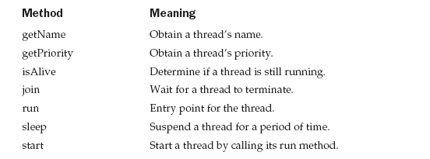
The Thread class defines several methods that help manage threads
DEPT OF CSE

Slide 18
The Main Thread
When a Java program starts up, one thread begins running immediately
This is usually called the main thread of your program, because it is the one that is executed when your program begins
It is the thread from which other “child” threads will be spawned
Often it must be the last thread to finish execution because it performs various shutdown actions
DEPT OF CSE

Slide 19
Although the main thread is created automatically when your program is started, it can be controlled through a Thread object
To do so, we must obtain a reference to it by calling the method currentThread( ), which is a public static member of Thread
static Thread currentThread( )
This method returns a reference to the thread in which it is called
DEPT OF CSE

Slide 20
// Controlling the main Thread.
class CurrentThreadDemo {
public static void main(String args[]) {
Thread t = Thread.currentThread();
System.out.println("Current thread: " + t);
// change the name of the thread
t.setName("My Thread");
System.out.println("After name change: " + t);
try {
for(int n = 5; n > 0; n--) {
System.out.println(n);
Thread.sleep(1000);
}
} catch (InterruptedException e) {
System.out.println("Main thread interrupted");
}
}
}
DEPT OF CSE

Slide 21
The argument to sleep( ) specifies the delay period in milliseconds
Output:
Current thread: Thread[main,5,main]
After name change: Thread[My Thread,5,main]
5
4
3
2
1
t displays the name of the thread, its priority, and the name of its group
DEPT OF CSE

Slide 22
By default, the name of the main thread is main.
Its priority is 5, which is the default value, and main is also the name of the group of threads to which this thread belongs
A thread group is a data structure that controls the state of a collection of threads as a whole
DEPT OF CSE

Slide 23
We can set the name of a thread by using setName( )
We can obtain the name of a thread by calling getName( )
static void sleep(long milliseconds) throws InterruptedException
static void sleep(long milliseconds, int nanoseconds) throws InterruptedException
DEPT OF CSE

Slide 24
Creating a Thread
DEPT OF CSE

Slide 25
We create a thread by instantiating an object of type Thread
We can implement the Runnable interface
We can extend the Thread class, itself
DEPT OF CSE

Slide 26
Implementing Runnable
We can construct a thread on any object that implements Runnable
To implement Runnable, a class need only implement a single method called run( ), which is declared like this:
public void run( )
DEPT OF CSE

Slide 27
Inside run( ), we will define the code that constitutes the new thread
run( ) establishes the entry point for another, concurrent thread of execution within our program
After we create a class that implements Runnable, we will instantiate an object of type Thread from within that class
DEPT OF CSE

Slide 28
The constructor is:
Thread(Runnable threadOb, String threadName)
threadOb is an instance of a class that implements the Runnable interface; This defines where execution of the thread will begin
The name of the new thread is specified by threadName
After the new thread is created, it will not start running until you call its start( ) method, which is declared within Thread
DEPT OF CSE

Slide 29
In essence, start( ) executes a call to run( )
void start( )
DEPT OF CSE

Slide 30
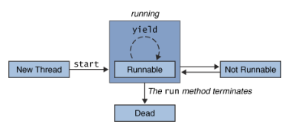
DEPT OF CSE

Slide 31
// Create a second thread.
class NewThread implements Runnable {
Thread t;
NewThread() {
// Create a new, second thread
t = new Thread(this, "Demo Thread");
System.out.println("Child thread: " + t);
t.start(); // Start the thread
}
// This is the entry point for the second thread.
public void run() {
try {
for(int i = 5; i > 0; i--) {
System.out.println("Child Thread: " + i);
Thread.sleep(500);
}
} catch (InterruptedException e) {
System.out.println("Child interrupted.");
}
System.out.println("Exiting child thread.");
} }
DEPT OF CSE

Slide 32
class ThreadDemo {
public static void main(String args[]) {
new NewThread(); // create a new thread
try {
for(int i = 5; i > 0; i--) {
System.out.println("Main Thread: " + i);
Thread.sleep(1000);
}
} catch (InterruptedException e) {
System.out.println("Main thread interrupted.");
}
System.out.println("Main thread exiting.");
}
}
DEPT OF CSE

Slide 33
Output:
Child thread: Thread[Demo Thread,5,main]
Main Thread: 5
Child Thread: 5
Child Thread: 4
Main Thread: 4
Child Thread: 3
Child Thread: 2
Main Thread: 3
Child Thread: 1
Exiting child thread.
Main Thread: 2
Main Thread: 1
Main thread exiting.
DEPT OF CSE

Slide 34
Extending Thread
The second way to create a thread is to create a new class that extends Thread, and then to create an instance of that class
The extending class must override the run( ) method, which is the entry point for the new thread
It must also call start( ) to begin execution of the new thread
DEPT OF CSE

Slide 35
// Create a second thread by extending Thread
class NewThread extends Thread {
NewThread() {
// Create a new, second thread
super("Demo Thread");
System.out.println("Child thread: " + this);
start(); // Start the thread
}
// This is the entry point for the second thread.
public void run() {
try {
for(int i = 5; i > 0; i--) {
System.out.println("Child Thread: " + i);
Thread.sleep(500);
}
} catch (InterruptedException e) {
System.out.println("Child interrupted.");
}
System.out.println("Exiting child thread.");
} }
DEPT OF CSE

Slide 36
class ExtendThread {
public static void main(String args[]) {
new NewThread(); // create a new thread
try {
for(int i = 5; i > 0; i--) {
System.out.println("Main Thread: " + i);
Thread.sleep(1000);
}
} catch (InterruptedException e) {
System.out.println("Main thread interrupted.");
}
System.out.println("Main thread exiting.");
}
}
DEPT OF CSE

Slide 37
Call to super( ) inside NewThread invokes the following form of the Thread constructor:
public Thread(String threadName)
Here, threadName specifies the name of the thread
DEPT OF CSE

Slide 38
Choosing an Approach
Which approach is better?
The Thread class defines several methods that can be overridden by a derived class
Of these methods, the only one that must be overridden is run( )
This is, of course, the same method required when you implement Runnable
Many Java programmers feel that classes should be extended only when they are being enhanced or modified in some way
DEPT OF CSE

Slide 39
So, if you will not be overriding any of Thread’s other methods, it is probably best simply to implement Runnable
But it is left to the programmers;
DEPT OF CSE

Slide 40
Creating Multiple Threads
DEPT OF CSE

Slide 41
So far, we have been using only two threads: the main thread and one child thread
However, our program can spawn as many threads as it needs
DEPT OF CSE

Slide 42
// Create multiple threads.
class NewThread implements Runnable {
String name; // name of thread
Thread t;
NewThread(String threadname) {
name = threadname;
t = new Thread(this, name);
System.out.println("New thread: " + t);
t.start(); // Start the thread
}
// This is the entry point for thread.
public void run() {
try {
for(int i = 5; i > 0; i--) {
System.out.println(name + ": " + i);
Thread.sleep(1000);
}
} catch (InterruptedException e) {
System.out.println(name + "Interrupted");
}
System.out.println(name + " exiting.");
} }
DEPT OF CSE

Slide 43
class MultiThreadDemo {
public static void main(String args[]) {
new NewThread("One"); // start threads
new NewThread("Two");
new NewThread("Three");
try {
// wait for other threads to end
Thread.sleep(10000);
} catch (InterruptedException e) {
System.out.println("Main thread Interrupted");
}
System.out.println("Main thread exiting.");
}
}
DEPT OF CSE

Slide 44
The output from this program is shown here:
New thread: Thread[One,5,main]
New thread: Thread[Two,5,main]
New thread: Thread[Three,5,main]
One: 5
Two: 5
Three: 5
One: 4
Two: 4
Three: 4
One: 3
Three: 3
Two: 3
One: 2
Three: 2
Two: 2
One: 1
Three: 1
Two: 1
One exiting.
Two exiting.
Three exiting.
Main thread exiting.
DEPT OF CSE

Slide 45
Using isAlive( ) and join( )
How can one thread know when another thread has ended?
Two ways exist to determine whether a thread has finished
First, you can call isAlive( ) on the thread
This method is defined by Thread, and its general form is
final boolean isAlive( )
DEPT OF CSE

Slide 46
The isAlive( ) method returns true if the thread upon which it is called is still running
It returns false otherwise
The method that you will more commonly use to wait for a thread to finish is called join( ), shown here:
final void join( ) throws InterruptedException
This method waits until the thread on which it is called terminates
DEPT OF CSE

Slide 47
// Using join() to wait for threads to finish.
class NewThread implements Runnable {
String name; // name of thread
Thread t;
NewThread(String threadname) {
name = threadname;
t = new Thread(this, name);
System.out.println("New thread: " + t);
t.start(); // Start the thread
}
// This is the entry point for thread.
public void run() {
try {
for(int i = 5; i > 0; i--) {
System.out.println(name + ": " + i);
Thread.sleep(1000);
}
} catch (InterruptedException e) {
System.out.println(name + " interrupted.");
}
System.out.println(name + " exiting.");
}
}
DEPT OF CSE

Slide 48
class DemoJoin {
public static void main(String args[]) {
NewThread ob1 = new NewThread("One");
NewThread ob2 = new NewThread("Two");
NewThread ob3 = new NewThread("Three");
System.out.println("Thread One is alive: "
+ ob1.t.isAlive());
System.out.println("Thread Two is alive: "
+ ob2.t.isAlive());
System.out.println("Thread Three is alive: "
+ ob3.t.isAlive());
// wait for threads to finish
try {
System.out.println("Waiting for threads to finish.");
ob1.t.join();
ob2.t.join();
ob3.t.join();
} catch (InterruptedException e) {
System.out.println("Main thread Interrupted");
}
System.out.println("Thread One is alive: "
+ ob1.t.isAlive());
System.out.println("Thread Two is alive: "
+ ob2.t.isAlive());
System.out.println("Thread Three is alive: "
+ ob3.t.isAlive());
System.out.println("Main thread exiting.");
}
}
DEPT OF CSE

Slide 49
Sample output from this program is shown here:
New thread: Thread[One,5,main]
New thread: Thread[Two,5,main]
New thread: Thread[Three,5,main]
Thread One is alive: true
Thread Two is alive: true
Thread Three is alive: true
Waiting for threads to finish.
One: 5
Two: 5
Three: 5
One: 4
Two: 4
Three: 4
One: 3
Two: 3
Three: 3
One: 2
Two: 2
Three: 2
One: 1
Two: 1
Three: 1
Two exiting.
Three exiting.
One exiting.
Thread One is alive: false
Thread Two is alive: false
Thread Three is alive: false
Main thread exiting.
DEPT OF CSE

Slide 50
Thread Priorities
final void setPriority(int level)
The value of level must be within the range MIN_PRIORITY and MAX_PRIORITY with values are 1 and 10, respectively.
Default priority, NORM_PRIORITY, is currently 5.
final int getPriority( )
DEPT OF CSE

Slide 51
volatile
The volatile modifier tells the compiler that the variable modified by volatile can be changed unexpectedly by other parts of your program
In a multithreaded program, sometimes, two or more threads share the same instance variable. For efficiency considerations, each thread can keep its own, private copy of such a shared variable. The real (or master) copy of the variable is updated at various times, such as when a synchronized method is entered. While this approach works fine, it may be inefficient at times. In some cases, all that really matters is that the master copy of a variable always reflects its current state. To ensure this, simply specify the variable as volatile, which tells the compiler that it must always use the master copy of a volatile variable (or, at least, always keep any private copies up to date with the master copy, and vice versa).

Slide 52
Volatile
The Java language specification allows the runtime system to keep a local copy of a variable in each thread that refers to it. These thread-local copies of a variable act like a cache to improve the performance of multi-threaded programs, they avoid having to check the true master value of the variable every time it is needed.
One consequence of this thread cache behavior is that at the moment of execution the value of thread-local variables may be different from the true master value of the variable. For variables whose value does not change frequently and would not critically affect the behavior of a program, thread-local cached values are a tolerable compromise of precision for the sake of better performance, if not they should be controlled.

Slide 53
// Demonstrate thread priorities.
class clicker implements Runnable {
int click = 0;
Thread t;
// volatile is used here to ensure that the value of running is examined each time the following loop iterates. The use of volatile tells Java that running may change in ways not directly apparent in the immediate code.
private volatile boolean running = true;
public clicker(int p) {
t = new Thread(this);
t.setPriority(p);
}
public void run() {
while (running) {
click++; } }
public void stop() {
running = false;
}
public void start() {
t.start(); } }
DEPT OF CSE

Slide 54
class HiLoPri {
public static void main(String args[]) {
Thread.currentThread().setPriority(Thread.MAX_PRIORITY);
clicker hi = new clicker(Thread.NORM_PRIORITY + 2);
clicker lo = new clicker(Thread.NORM_PRIORITY - 2);
lo.start();
hi.start();
try {
Thread.sleep(10000);
} catch (InterruptedException e) {
System.out.println("Main thread interrupted.");
}
lo.stop();
hi.stop();
// Wait for child threads to terminate.
try {
hi.t.join();
lo.t.join();
} catch (InterruptedException e) {
System.out.println("InterruptedException caught");
}
System.out.println("Low-priority thread: " + lo.click);
System.out.println("High-priority thread: " + hi.click);
}
}
DEPT OF CSE

Slide 55
The higher-priority thread got approximately 90 percent of the CPU time.
Low-priority thread: 4408112
High-priority thread: 589626904
DEPT OF CSE

Slide 56
Synchronization
When two or more threads need access to a shared resource, they need some way to ensure that the resource will be used by only one thread at a time
The process by which this is achieved is called synchronization
Key to synchronization is the concept of the monitor (like semaphore)
DEPT OF CSE

Slide 57
A monitor is an object that is used as a mutually exclusive lock, or mutex
Only one thread can own a monitor at a given time
When a thread acquires a lock, it is said to have entered the monitor
All other threads attempting to enter the locked monitor will be suspended until the first thread exits the monitor
These other threads are said to be waiting for the monitor
DEPT OF CSE

Slide 58
Using Synchronized Methods
// This program is not synchronized.
class Callme {
void call(String msg) {
System.out.print("[" + msg);
try {
Thread.sleep(1000);
} catch(InterruptedException e) {
System.out.println("Interrupted");
}
System.out.println("]");
}
}
DEPT OF CSE

Slide 59
class Caller implements Runnable {
String msg;
Callme target;
Thread t;
public Caller(Callme targ, String s) {
target = targ;
msg = s;
t = new Thread(this);
t.start();
}
public void run() {
target.call(msg);
}
}
DEPT OF CSE

Slide 60
class Synch {
public static void main(String args[]) {
Callme target = new Callme();
Caller ob1 = new Caller(target, "Hello");
Caller ob2 = new Caller(target, "Synchronized");
Caller ob3 = new Caller(target, "World");
// wait for threads to end
try {
ob1.t.join();
ob2.t.join();
ob3.t.join();
} catch(InterruptedException e) {
System.out.println("Interrupted");
}
}
}
DEPT OF CSE

Slide 61
Here is the output produced by this program:
[Hello[Synchronized[World]
]
]
DEPT OF CSE

Slide 62
In this program, nothing exists to stop all three threads from calling the same method, on the same object, at the same time
This is known as a race condition, because the three threads are racing each other to complete the method
In most situations, a race condition is more subtle and less predictable, because you can’t be sure when the context switch will occur
DEPT OF CSE

Slide 63
To fix the preceding program, you must serialize access to call( )
To do this, you simply need to precede call()’s definition with the keyword synchronized
class Callme {
synchronized void call(String msg) {
...
This prevents other threads from entering call( ) while another thread is using it
DEPT OF CSE

Slide 64
After synchronized has been added to call(), the output of the program is as follows:
[Hello]
[Synchronized]
[World]
Once a thread enters any synchronized method on an instance, no other thread can enter any other synchronized method on the same instance
However, nonsynchronized methods on that instance will continue to be callable
DEPT OF CSE

Slide 65
The synchronized Statement
Imagine that you want to synchronize access to objects of a class that was not designed for multithreaded access
That is, the class does not use synchronized methods
Further, this class was not created by you, but by a third party, and you do not have access to the source code
Thus, you can’t add synchronized to the appropriate methods within the class
DEPT OF CSE

Slide 66
How can access to an object of this class be synchronized?
DEPT OF CSE

Slide 67
You simply put calls to the methods defined by this class inside a synchronized block
DEPT OF CSE

Slide 68
This is the general form of the synchronized statement:
synchronized(object) {
// statements to be synchronized
}
Here, object is a reference to the object being synchronized
A synchronized block ensures that a call to a method that is a member of object occurs only after the current thread has successfully entered object’s monitor
DEPT OF CSE

Slide 69
// This program uses a synchronized block.
class Callme {
void call(String msg) {
System.out.print("[" + msg);
try {
Thread.sleep(1000);
} catch (InterruptedException e) {
System.out.println("Interrupted");
}
System.out.println("]");
}
}
DEPT OF CSE

Slide 70
class Caller implements Runnable {
String msg;
Callme target;
Thread t;
public Caller(Callme targ, String s) {
target = targ;
msg = s;
t = new Thread(this);
t.start();
}
// synchronize calls to call()
public void run() {
synchronized(target) { // synchronized block
target.call(msg);
}
}
}
DEPT OF CSE

Slide 71
class Synch1 {
public static void main(String args[]) {
Callme target = new Callme();
Caller ob1 = new Caller(target, "Hello");
Caller ob2 = new Caller(target, "Synchronized");
Caller ob3 = new Caller(target, "World");
// wait for threads to end
try {
ob1.t.join();
ob2.t.join();
ob3.t.join();
} catch(InterruptedException e) {
System.out.println("Interrupted");
}
}
}
DEPT OF CSE

Slide 72
Interthread Communication
DEPT OF CSE

Slide 73
Java includes an elegant interprocess communication mechanism via the wait( ), notify( ), and notifyAll( ) methods
All three methods can be called only from within a synchronized context
wait( ) tells the calling thread to give up the monitor and go to sleep until some other thread enters the same monitor and calls notify( )
DEPT OF CSE

Slide 74
notify( ) wakes up the first thread that called wait( ) on the same object
notifyAll( ) wakes up all the threads that called wait( ) on the same object; The highest priority thread will run first.
DEPT OF CSE

Slide 75
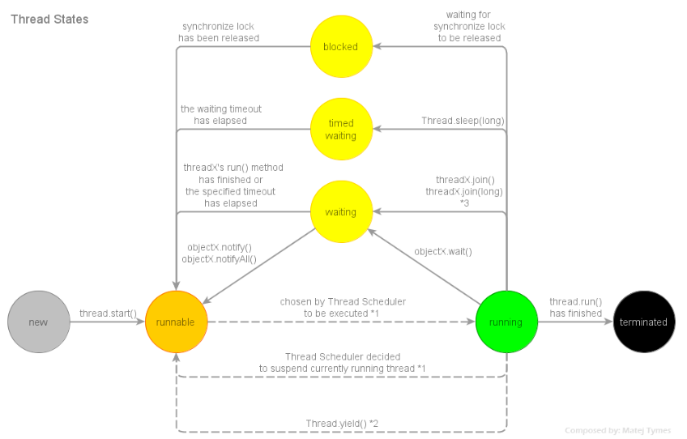
DEPT OF CSE

Slide 76
Producer ConsumerProblem
// An incorrect implementation of a producer and consumer.
class Q {
int n;
synchronized int get()
{ System.out.println("Got: " + n);
return n; }
synchronized void put(int n)
{ this.n = n;
System.out.println("Put: " + n);
}
}

Slide 77
Producer ConsumerProblem
class Producer implements Runnable
{
Q q;
Producer(Q q) {
this.q = q;
new Thread(this, "Producer").start();
}
public void run() { int i = 0;
while(true) { q.put(i++);
}
}
}

Slide 78
Producer ConsumerProblem
class Consumer implements Runnable
{
Q q;
Consumer(Q q) {
this.q = q;
new Thread(this, "Consumer").start();
}
public void run() {
while(true) {
q.get(); }
}
}

Slide 79
Producer ConsumerProblem
class PC {
public static void main(String args[]) {
Q q = new Q();
new Producer(q);
new Consumer(q);
System.out.println("Press Control-C to stop.");
}
}

Slide 80
class Q {
int n;
boolean valueSet = false;
synchronized int get() {
if(!valueSet)
try {
wait();
} catch(InterruptedException e) {
System.out.println("InterruptedException caught");
}
System.out.println("Got: " + n);
valueSet = false;
notify();
return n;
}
DEPT OF CSE

Slide 81
synchronized void put(int n) {
if(valueSet)
try {
wait();
} catch(InterruptedException e) {
System.out.println("InterruptedException caught");
}
this.n = n;
valueSet = true;
System.out.println("Put: " + n);
notify();
}
}
DEPT OF CSE

Slide 82
class Producer implements Runnable {
Q q;
Producer(Q q) {
this.q = q;
new Thread(this, "Producer").start();
}
public void run() {
int i = 0;
while(true) {
q.put(i++);
}
}
}
DEPT OF CSE

Slide 83
class Consumer implements Runnable {
Q q;
Consumer(Q q) {
this.q = q;
new Thread(this, "Consumer").start();
}
public void run() {
while(true) {
q.get();
}
}
}
DEPT OF CSE

Slide 84
class ProducerConsumer {
public static void main(String args[]) {
Q q = new Q();
new Producer(q);
new Consumer(q);
System.out.println("Press Control-C to stop.");
}
}
DEPT OF CSE

Slide 85
Output:
Put: 1
Got: 1
Put: 2
Got: 2
Put: 3
Got: 3
Put: 4
Got: 4
Put: 5
Got: 5
DEPT OF CSE

Slide 86
Deadlock
Deadlock occurs when two threads have a circular dependency on a pair of synchronized objects.
Suppose one thread enters the monitor on object X and another thread enters the monitor on object Y.
If the thread in X tries to call any synchronized method on Y, it will block as expected.
If the thread in Y, in turn, tries to call any synchronized method on X, the thread waits forever, because to access X, it would have to release its own lock on Y so that the first thread could complete.
DEPT OF CSE

Slide 87
Deadlock is a difficult error to debug for two reasons:
  ■ Two threads time-slice in just the right way.
  ■ It may involve more than two threads and two synchronized objects.
DEPT OF CSE

Slide 88
// An example of deadlock.
class A {
synchronized void foo(B b) {
String name = Thread.currentThread().getName();
System.out.println(name + " entered A.foo");
try {
Thread.sleep(1000);
} catch(Exception e) {
System.out.println("A Interrupted");
}
System.out.println(name + " trying to call B.last()");
b.last();
}
synchronized void last() {
System.out.println("Inside A.last");
}
}
DEPT OF CSE

Slide 89
class B {
synchronized void bar(A a) {
String name = Thread.currentThread().getName();
System.out.println(name + " entered B.bar");
try {
Thread.sleep(1000);
} catch(Exception e) {
System.out.println("B Interrupted");
}
System.out.println(name + " trying to call A.last()");
a.last();
}
synchronized void last() {
System.out.println("Inside A.last");
}
}
DEPT OF CSE

Slide 90
class Deadlock implements Runnable {
A a = new A();
B b = new B();
Deadlock() {
Thread.currentThread().setName("MainThread");
Thread t = new Thread(this, "RacingThread");
t.start();
a.foo(b); // get lock on a in this thread.
System.out.println("Back in main thread");
}
public void run() {
b.bar(a); // get lock on b in other thread.
System.out.println("Back in other thread");
}
public static void main(String args[]) {
new Deadlock();
}
}
DEPT OF CSE

Slide 91
The output is as shown :
  MainThread entered A.foo
  RacingThread entered B.bar
  MainThread trying to call B.last()
  RacingThread trying to call A.last()
DEPT OF CSE

Slide 92
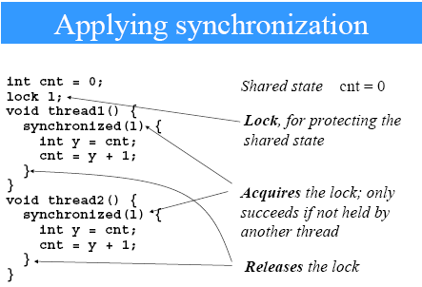
DEPT OF CSE

Slide 93
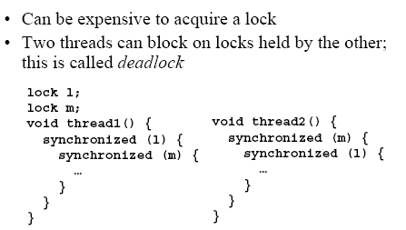
DEPT OF CSE

Slide 94
Wait and Notify: Code
Consumer:
  synchronized (lock) {
  while (!resourceAvailable()) {
  lock.wait();
  }
  consumeResource();
  }

Slide 95
Wait and Notify: Code
Producer:
  produceResource();
  synchronized (lock) {
  lock.notifyAll();
  }

Slide 96
Wait/Notify Sequence
Lock Object
1. synchronized(lock){
3. produceResource()
2. lock.wait();
4. synchronized(lock) {
9. consumeResource();
5. lock.notify();
10. }
6.}
7. Reacquire lock
8. Return from wait()
Consumer
Thread
Producer
Thread

Slide 97
Wait/Notify Sequence
Lock Object
1. synchronized(lock){
3. produceResource()
2. lock.wait();
4. synchronized(lock) {
9. consumeResource();
5. lock.notify();
10. }
6.}
7. Reacquire lock
8. Return from wait()
Consumer
Thread
Producer
Thread

Slide 98
Wait/Notify Sequence
Lock Object
1. synchronized(lock){
3. produceResource()
2. lock.wait();
4. synchronized(lock) {
9. consumeResource();
5. lock.notify();
10. }
6.}
7. Reacquire lock
8. Return from wait()
Consumer
Thread
Producer
Thread

Slide 99
Wait/Notify Sequence
Lock Object
1. synchronized(lock){
3. produceResource()
2. lock.wait();
4. synchronized(lock) {
9. consumeResource();
5. lock.notify();
10. }
6.}
7. Reacquire lock
8. Return from wait()
Consumer
Thread
Producer
Thread

Slide 100
Wait/Notify Sequence
Lock Object
1. synchronized(lock){
3. produceResource()
2. lock.wait();
4. synchronized(lock) {
9. consumeResource();
5. lock.notify();
10. }
6.}
7. Reacquire lock
8. Return from wait()
Consumer
Thread
Producer
Thread

Slide 101
Wait/Notify Sequence
Lock Object
1. synchronized(lock){
3. produceResource()
2. lock.wait();
4. synchronized(lock) {
9. consumeResource();
5. lock.notify();
10. }
6.}
7. Reacquire lock
8. Return from wait()
Consumer
Thread
Producer
Thread

Slide 102
Wait/Notify Sequence
Lock Object
1. synchronized(lock){
3. produceResource()
2. lock.wait();
4. synchronized(lock) {
9. consumeResource();
5. lock.notify();
10. }
6.}
7. Reacquire lock
8. Return from wait()
Consumer
Thread
Producer
Thread

Slide 103
Wait/Notify Sequence
Lock Object
1. synchronized(lock){
3. produceResource()
2. lock.wait();
4. synchronized(lock) {
9. consumeResource();
5. lock.notify();
10. }
6.}
7. Reacquire lock
8. Return from wait()
Consumer
Thread
Producer
Thread

Slide 104
Wait/Notify Sequence
Lock Object
1. synchronized(lock){
3. produceResource()
2. lock.wait();
4. synchronized(lock) {
9. consumeResource();
5. lock.notify();
10. }
6.}
7. Reacquire lock
8. Return from wait()
Consumer
Thread
Producer
Thread

Slide 105
Wait/Notify Sequence
Lock Object
1. synchronized(lock){
3. produceResource()
2. lock.wait();
4. synchronized(lock) {
9. consumeResource();
5. lock.notify();
10. }
6.}
7. Reacquire lock
8. Return from wait()
Consumer
Thread
Producer
Thread

Slide 106
Wait/Notify Sequence
Lock Object
1. synchronized(lock){
3. produceResource()
2. lock.wait();
4. synchronized(lock) {
9. consumeResource();
5. lock.notify();
10. }
6.}
7. Reacquire lock
8. Return from wait()
Consumer
Thread
Producer
Thread

Slide 107
Wait/Notify: Details
Often the lock object is the resource itself
Sometimes the lock object is the producer thread itself

Slide 108
Wait/Notify: Details
Must loop on wait(), in case another thread grabs the resource...
  After you are notified
  Before you acquire the lock and return from wait()
Use lock.notifyAll() if there may be more than one waiting thread

Slide 109
Class Nthread implements Runnable
{ Thread t;
int r=0,n;
rthread(int a)
{t=newthread();
T.start();
R=a;
}
Public void run()
{
for( int i=0;i<rowsum.mat[0].length;i++)
{rs=rowsum.mat[r][i];
try
{ Thread.sleep(1000); }

Slide 110
Catch(InterruptedException e)
{
system.out.println(“Interruped “);}
} } }
Class Rowsum
{
static int mat[][]={{1,2,3},{4,5,6},{7,8,9}};
public static void main(String s[])
{
rthread rt[] =new rthread[10];
for(int i=0;i<mat.length;i++)
{
rt[i]=new rthread[i]; }
try {
Thread.sleep(500);}
Catch(Exception e){
}
Try {
for(int i=0;i<mat.length;i++)

Slide 111
rt[i].t.join(); }
catch(InterruptedException e){
}
int sum=0;
for(int i=0;i<mat.length;i++)
sum t=rt[i].rs;
System.out.println(“ SUM is : “+sum);
}
}

Slide 112
DeadLock
This occurs when two threads have a circular dependency on a pair of synchronized objects.
X Y
T2
T1

Slide 113
EXample
// An example of deadlock.
class A {
synchronized void foo(B b) {
String name = Thread.currentThread().getName();
System.out.println(name + " entered A.foo");
try {
Thread.sleep(1000);
} catch(Exception e) {
System.out.println("A Interrupted");
}
System.out.println(name + " trying to call B.last()");
b.last();

Slide 114
}
synchronized void last() {
System.out.println("Inside A.last");
}
}
class B {
synchronized void bar(A a) {
String name = Thread.currentThread().getName();
System.out.println(name + " entered B.bar");
try {
Thread.sleep(1000);
} catch(Exception e) {
System.out.println("B Interrupted");

Slide 115
}
System.out.println(name + " trying to call A.last()");
a.last();
}
synchronized void last() {
System.out.println("Inside A.last");
}
}
class Deadlock implements Runnable {
A a = new A();
B b = new B();
Deadlock() {
Thread.currentThread().setName("MainThread");

Slide 116
Thread t = new Thread(this, "RacingThread");
t.start();
a.foo(b); // get lock on a in this thread.
System.out.println("Back in main thread");
}
public void run() {
b.bar(a); // get lock on b in other thread.
System.out.println("Back in other thread");
}
public static void main(String args[]) {
new Deadlock();
}
}

Slide 117
END OF UNIT - 3
DEPT OF CSE

